Slide 1
Modulation of Fentanyl Consumption and Reward By the CLaustrum
Yonatan Fatal
Instructor: Professor Ami Citri
August 5th, 2021

Slide 2
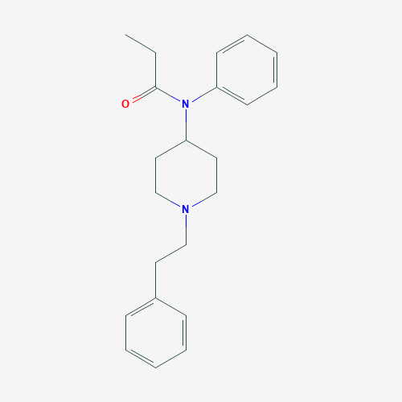
Layout
Intro
Fentanyl – a lethal pain killer
Claustrum – anatomy and function
Main
Claustral neurons are recruited by fentanyl
The Claustrum modulates fentanyl conditioned place-preference
The Claustrum affects oral self-administration of fentanyl
The Claustrum modulates cortical response for fentanyl
Summary
Study limitations
Future plans
Fentanyl (PubChem)
The Claustrum
(Trends in Neurosciences)

Slide 3
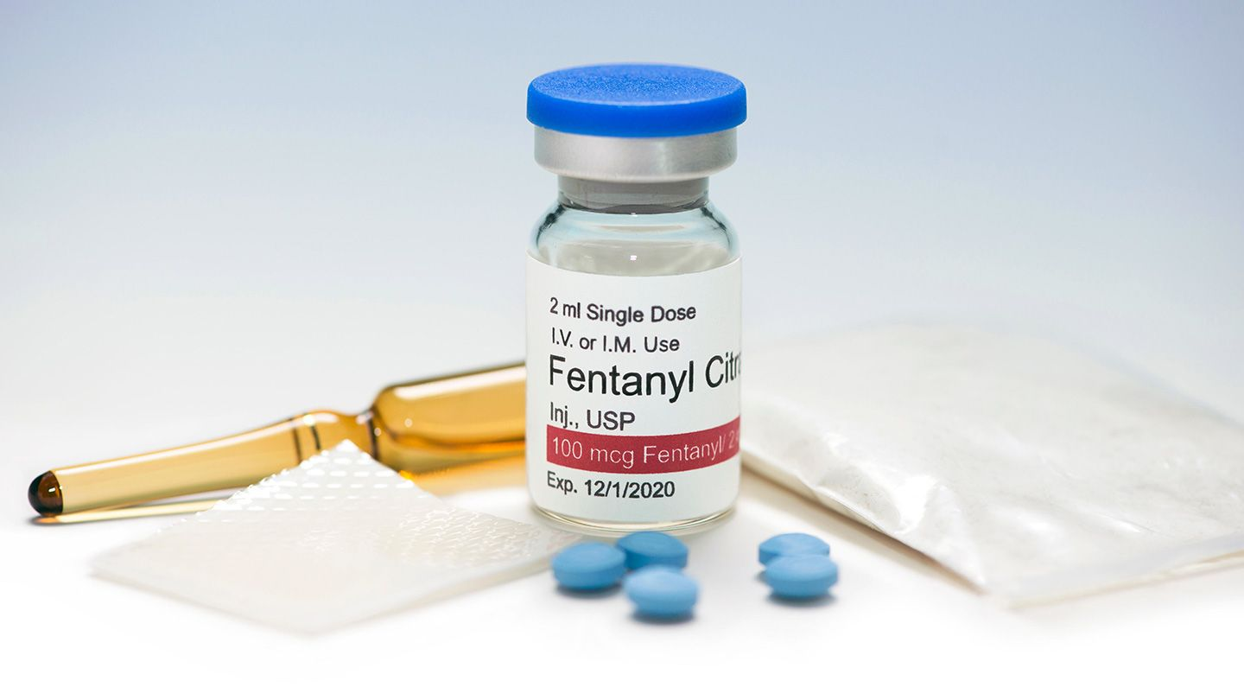
Fentanyl - Overview
Powerful analgesic substance
Rapid effect (crosses lipid membranes)
Binds to Opioid Receptors
(Affinity - 50-100 times stronger than Morphine)
In 2018, almost 50,000 people died from overdose of opioids in North America alone. Fentanyl is responsible for about half of the cases.
Fentanyl patch, pills, ampullas and powder (source)
Fischer et al., 2020

Slide 4
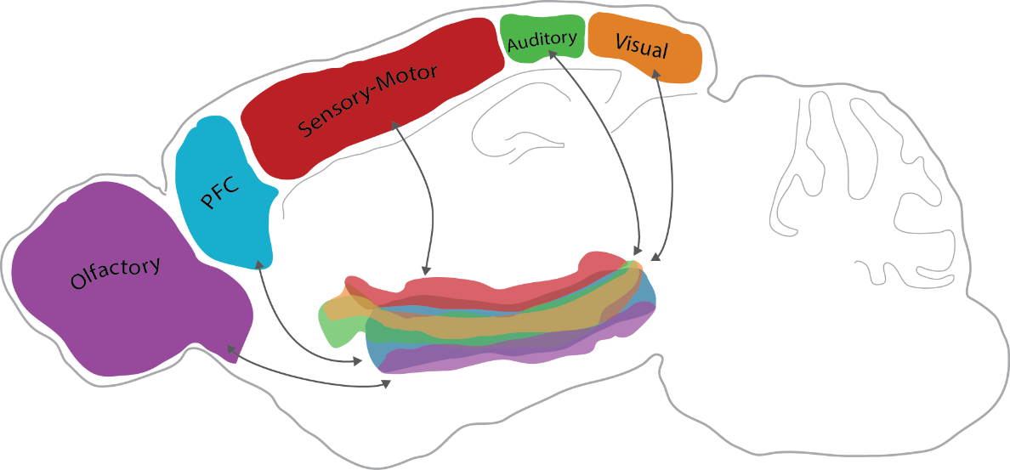
The Claustrum - Function
Atlan et al. 2016
Consciousness and integration of sensory inputs
(Crick & Koch, 2005; Koubeissi et al., 2014; Bayat et al., 2018)
Attention, Cognitive control
(Goll et al., 2015; Atlan & Terem, 2018;
White et al., 2018; Jackson et al., 2018)
Saliency detection
(Remedios et al., 2010, 2014)
Slow Wave activity
(Nariyiko et al,. 2020)
The Claustrum (in the middle) receives input from multiple cortical regions (Atlan et al., 2017)

Slide 5
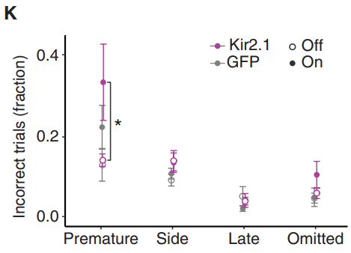
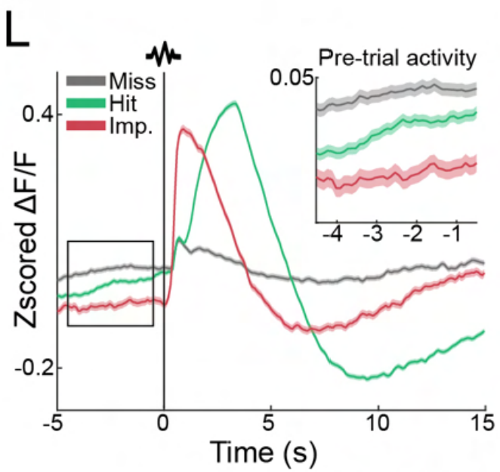
Claustral Activity Predicts Impulsivity
Atlan, Terem, Peretz-Rivlin, 2018, Current Biology
Atlan et al., 2021, in press

Slide 6
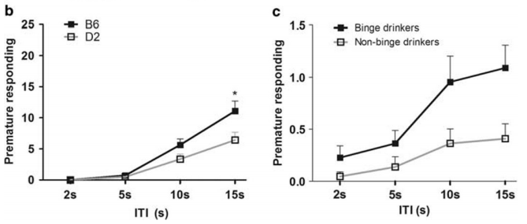
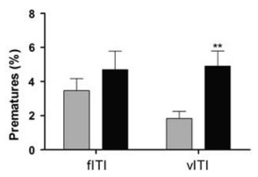
Impulsivity and Drug Consumption
D2 – mouse strain which shows weaker additictive phenotypes (DBA2/J)
Human participants
Binge drinkers - “Binge Score”
A harder version of 5CSRTT (moving targets)
vITI - variable inter-trial interval
Sanchez-Roige et al., 2014

Slide 7
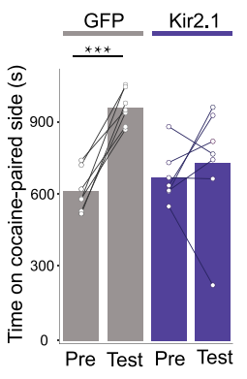
The Claustrum and Drug Reward
Conditioned Place Preference Paradigm
Kir2.1 – Inhibitory channel exclusively
expressed in claustral projection neurons.
Terem et al., 2020, Current Biology

Slide 8
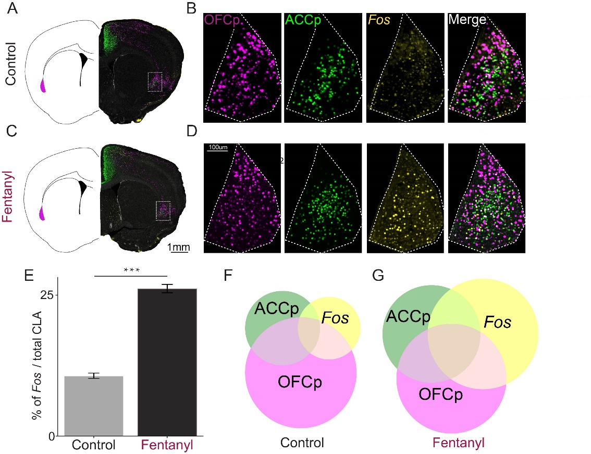
Fentanyl Induces IEG expression in frontal-projecting neurons in the CLA
ACC- and OFC-projecting cells were labeled
using AAV retrovirsues injected to ACC, OFC respectively.
Fos expression was visualized using immunohistochemistry

Slide 9
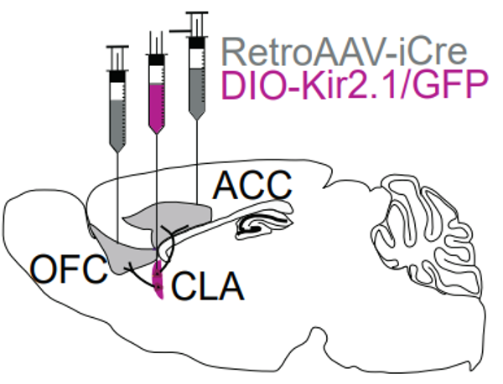
Conditional Virus Expression allows for Inhibition of frontal-projecting CLA neurons
Retroviruses were injected to ACC and OFC, leading ACCp and OFCp cells to express Cre.
A Cre-dependent virus was injected to the CLA, encoding for the potassium channel Kir2.1. Expression of this channel leads to constitutive hyper-polarization of the infected neurons, eliminating their ability to produce action potentials.
Terem et al., 2020; Mukherjee & Gonzales et al., 2021

Slide 10
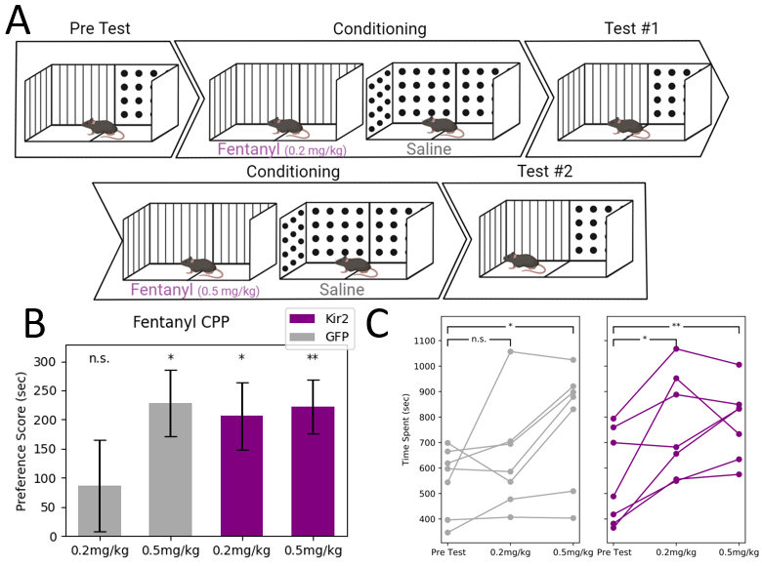
The Claustrum Modulates Fentanyl Conditioned Place Preference

Slide 11
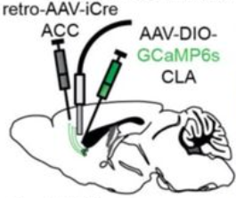
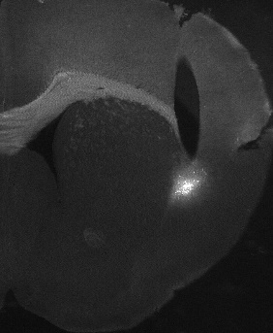
Fiber Photometry From the Claustrum During Fentanyl Oral Self-Administration
GCaMP is a fluorescent protein sensitive to cellular concentrations of Ca++.
Recording Ca++ signal from the CLA during self-administration of fentanyl allows for characterization of claustral responses to the consumption.

Slide 12
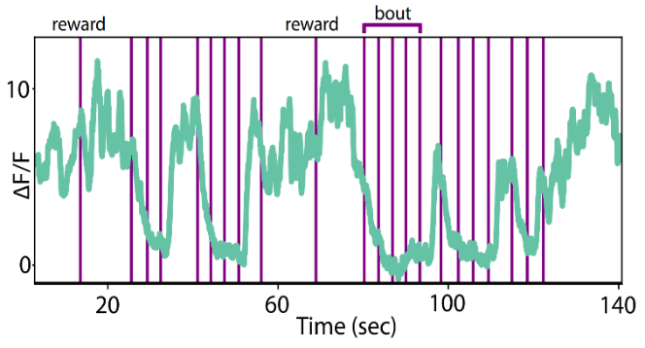
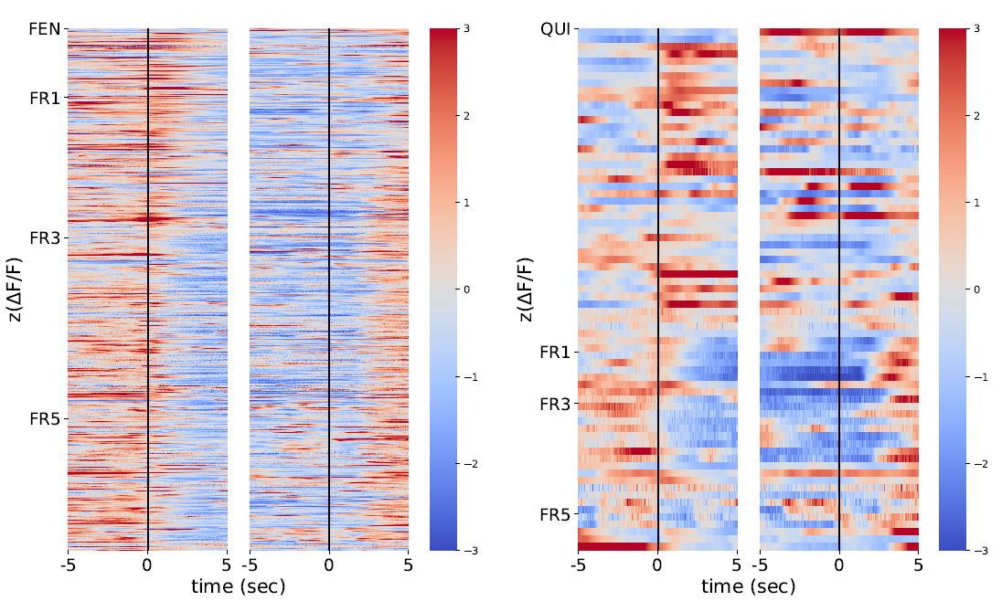
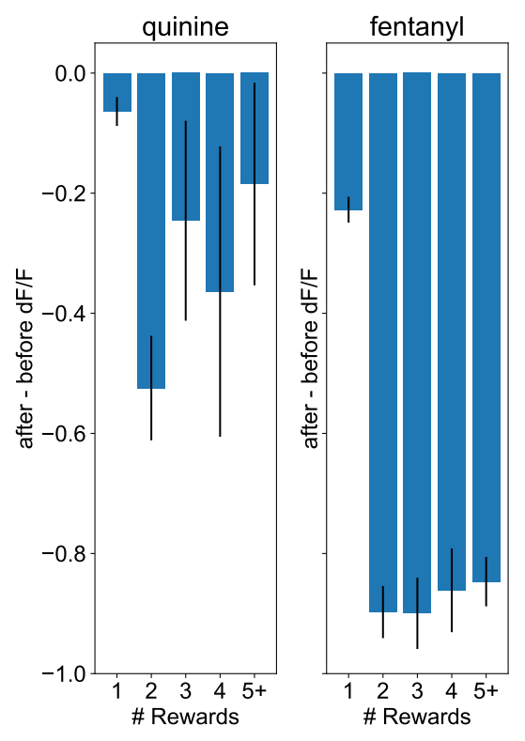
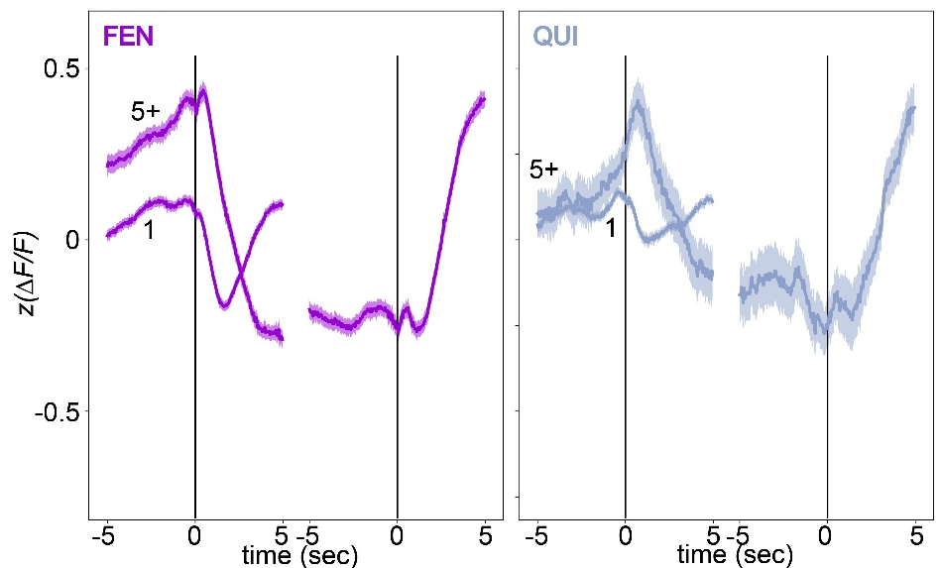
Fentanyl Drinking Sequences are Represented by Unique Activity Patterns of ACCp
E
F
(E) Representative trace of Ca++ signal from 150 seconds of recording. Purple lines denote rewards. Note the decrease in signal around long sequences of drinking, which does not occur around single rewards.
(F) Heatmap of signal in a window of +- 5 seconds around bout start and end. Bouts are defined as sequences of 5 rewards or more, with no more than 6 seconds between consecutive rewards. (G) Difference between average signal prior to bout start (-5 to -1 seconds) and signal after bout start (+1 to +5), as a function of bout length, separated by liquid. Numbers denote the total number of signal traces counted. Error bars represent s.e.m.
(H) The 5+ traces are average of F. The traces marked as “1” are an average of all single rewards. Shaded error bars represent s.e.m.
G
H

Slide 13
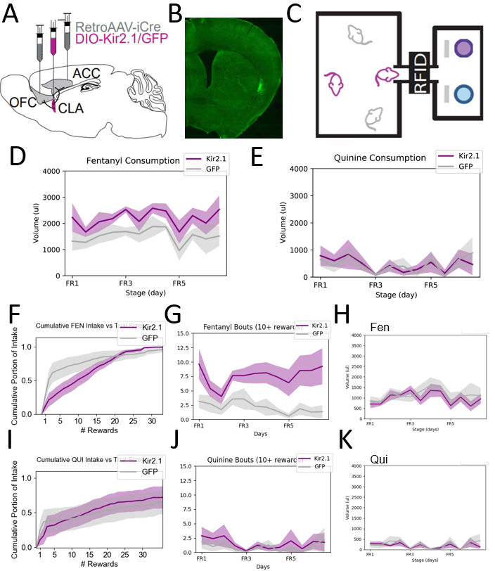
Inhibition of Frontal-Projecting Neurons in the CLA increases Fentanyl intake

Slide 14
Long Drinking Sequences Account for the Difference in Fentanyl Intake
(F) Cumulative Distribution Functions for the part of consumption obtained by trials of different sizes. GFP and Kir2.1 groups display different CDF. KS Test, p=3.7E-22.
(G) Kir2.1 mice perform more fentanyl bouts (trials with 10 rewards or more) (p=0.00253). (H) Removal of long trials alleviates the difference in total fentanyl consumption between the groups (p=0.55). (I) Kir2.1 and GFP groups display statistically different CDF for quinine bouts (KS test, p=0.002). (J) Both groups display similar numbers of quinine bouts (ANOVA on mixed linear model, p=0.387). (K) Removal of quinine bouts maintains no difference between the groups (ANOVA on mixed linear model, p=0.65)

Slide 15
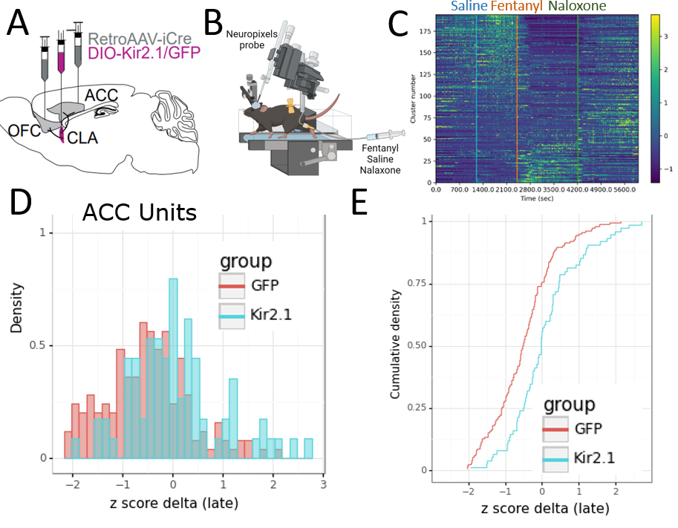
The Claustrum Possibly Affects Cortical Response for Fentanyl
For in-vivo extra-cellular electrophysiology recording from the cortex, we used Neuropixels 1.0 – a multi-electrode silicon probe produced by Imec. Neuropixels probes allow for simultaneous recording from 384 channels.
The heatmap in (C) shows a representative recording, where we injected saline, fentanyl and naloxone. Each row is a unit (presumably a cell). Color represents normalized firing in bins of 7 seconds. For each row, we quantified the effect of fentanyl by calculating average z-score after fentanyl minus average z-score after saline. The distribution of delta z-score, in units located at the ACC, is presented in D and E.

Slide 16
Study Limitations
The study does not show a true preference for fentanyl over water, only over quinine. Further experiments are needed to prove that fentanyl consumption was not only due to quinine aversion.
Photometry data only describes ACCp activity. We currently repeat this experiment with GCaMP in OFCp.
Even though ACCp and OFCp account for most Fos expression in the CLA following fentanyl, other population can contribute to this response as well.
Physiological data is preliminary and requires further repetitions,

Slide 17
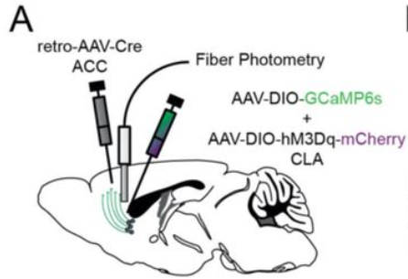
Future Experiments
Hyper-activation of the CLA => Less Fentanyl Consumption?
Optogenetic activation of the CLA during drinking => Drinking Termination?
Does premature reaction in an attentional task correlate with fentanyl binge drinking and increased fentanyl intake?

Slide 18
Acknowledgments
The project was performed in the lab of Professor Ami Citri, in the Hebrew University.
I would like to thank Professor Citri and my mentor, Anna Terem, for opening me a door to science, guiding me through fascinate
I thank Noa Peretz-Rivlin for her kind mentorship, teaching me to perform highly sensitive experiments.
Dr. Hagit Turm had an essential part in the conceptualization of the study and establishment of experimental setupsing scientific questions.
Prof. Ami Citri
Dr. Hagit Turm
Noa Peretz-Rivlin
Anna Terem

